Slide 1
Our Understanding of the Project
CMU Delphi group supports and advises the U.S. CDC’s community-driven COVID-19 forecasting effort by collecting Covid data across states. DELPHI is working to create alternative data sources for information related to the pandemic which can be leveraged by policy makers and researchers. (Report)
Research question: “When two different data signals are getting at the same concept, do they agree?”
Our aim is to
Identify and implement effective ways to determine if two signals are in agreement
If two signals disagree, investigate and provide insights into reasons for the disagreement

Slide 2
COVIDcast Epidata API
One of the endpoints of Delphi’s epidemiological data API
Can be accessed through dedicated covidcast library in R and Python
13 data sources with about 100 signals in total
At the outset, we’d like to understand all the data sources and signals to identify the ones which can be compared. Are there signals we should focus on? How exhaustive should our search be?

Slide 3
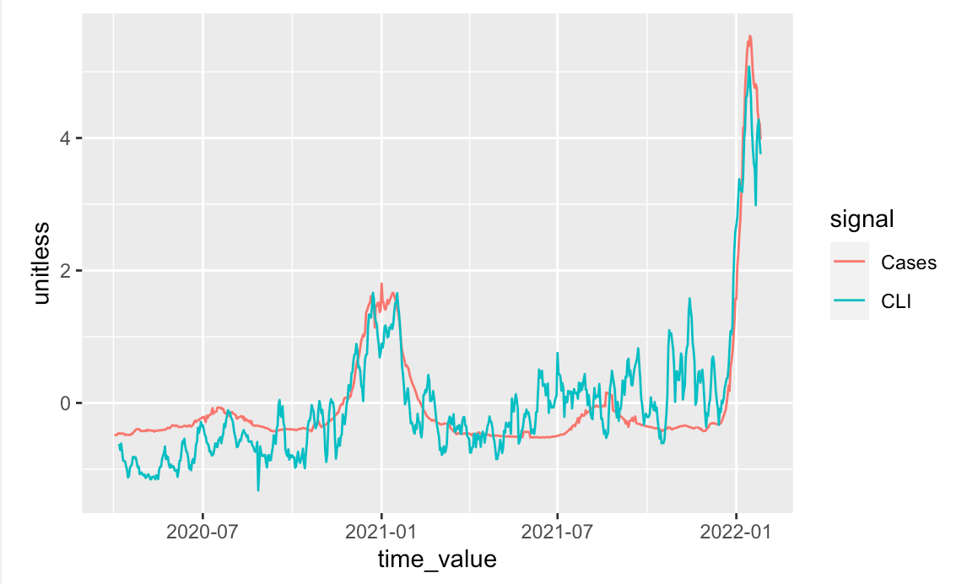
Reproducing Graphs
Possible reason for disagreement in signals could be due to spike in flu cases
Can be validated using flu data available on the API

Slide 4
Weekly meeting times with Prof Ventura and Prof Bien?
How is the communication between the group, Prof Ventura and Prof Bien going to work?

